Slide 1



REPET: REpeating Pattern Extraction Technique A Simple Music/Voice Separation Method based on the Extraction of the Underlying Repeating Structure Zafar RAFII
interactive audio Lab

Slide 2
Plan
Introduction
REPET Algorithm
Repeating period identification
Repeating segment modeling
Repeating structure extraction
Music/Voice Separation
Experimental results
Audio examples
Future work
Conclusion

Slide 3

I. Introduction
Repetition is a core principle in music: a musical piece has generally a distinguishable underlying repeating structure

Slide 4
I. Introduction
Assuming sparsity in time and frequency, there should be (roughly) periodically repeating & non-repeating t-f bins

Slide 5

I. Introduction
Assuming sparsity in time and frequency, there should be (roughly) periodically repeating & non-repeating t-f bins
repeating
non-repeating

Slide 6
I. Introduction
Idea: identify time-frequency bins periodically repeating in the spectrogram and extract them via binary masking
Method: REpeating Patterns Extraction Technique (REPET)
Identify a repeating period
Model a repeating segment
Extract the repeating structure
Result: a simple music/voice separation system!
The underlying repeating structure ≈ musical "background"
The overlying non-repeating structure ≈ vocal "foreground"

Slide 7


I. Introduction
Parallel with background subtraction in computer vision:
Compare frames to estimate a "background model"

Slide 8
I. Introduction
Parallel with background subtraction in computer vision:
Extract the "background" from the "foreground"

Slide 9
I. Introduction
Parallel with background subtraction in computer vision:
With audio, we also need to identify a repeating period!

Slide 10
I. Introduction
Practical Interest:
Instruments/vocalist identification
Music/voice transcription
Post production
Karaoke
Practical Advantages:
Not feature-dependent
No complex framework
No prior training
Intellectual Interest:
Simply based on repetition
Musical structure extraction

Slide 11
Plan
Introduction
REPET Algorithm
Repeating period identification
Repeating segment modeling
Repeating structure extraction
Music/Voice Separation
Experimental results
Audio examples
Future work
Conclusion

Slide 12
II. REPET – 1. Repeating Period
A correlogram is calculated from the autocorrelation of the rows of the power spectrogram to detect periodicities

Slide 13
II. REPET – 1. Repeating Period
By taking the mean of the rows of the correlogram, we obtain the "beat spectrum"

Slide 14
II. REPET – 1. Repeating Period
The beat spectrum reveals the repeating period P of the underlying repeating musical structure
P
2P
3P
4P
5P
6P
7P

Slide 15
II. REPET – 1. Repeating Period
The beat spectrum reveals the repeating period P of the underlying repeating musical structure
P
2P
3P
4P
5P
6P
7P

Slide 16
Plan
Introduction
REPET Algorithm
Repeating period identification
Repeating segment modeling
Repeating structure extraction
Music/Voice Separation
Evaluation
Examples
Future
Conclusion

Slide 17
II. REPET – 2. Repeating Segment
The repeating period is used to segment the magnitude spectrogram at period rate

Slide 18
II. REPET – 2. Repeating Segment
The repeating segment is modeled as the median of the segments for every t-f bins
median

Slide 19
II. REPET – 2. Repeating Segment
As the middle value of a distribution, the median helps to model a smooth repeating segment, eliminating outliers
median

Slide 20
II. REPET – 2. Repeating Segment
As the middle value of a distribution, the median helps to model a smooth repeating segment, eliminating outliers
median

Slide 21
Plan
Introduction
REPET Algorithm
Repeating period identification
Repeating segment modeling
Repeating structure extraction
Music/Voice Separation
Experimental results
Audio examples
Future work
Conclusion

Slide 22
II. REPET – 3. Repeating Structure
The repeating segment is used to divide bin-wise each segment in order to obtain a median-scaled spectrogram

Slide 23
II. REPET – 3. Repeating Structure
The repeating segment is used to divide bin-wise each segment in order to obtain a median-scaled spectrogram

Slide 24
II. REPET – 3. Repeating Structure
The repeating segment is used to divide bin-wise each segment in order to obtain a median-scaled spectrogram

Slide 25
II. REPET – 3. Repeating Structure
Repeating t-f bins are similar to the repeating segment, so have values around 1 in the median-scaled spectrogram

Slide 26
II. REPET – 3. Repeating Structure
Repeating t-f bins are similar to the repeating segment, so have values around 1 in the median-scaled spectrogram
1
1
median
division

Slide 27
II. REPET – 3. Repeating Structure
By assigning bins around 1 to the repeating structure (white) and the rest to 0 (black), we get a binary t-f mask
1
1
median
division

Slide 28
II. REPET – 3. Repeating Structure
By assigning bins around 1 to the repeating structure (white) and the rest to 0 (black), we get a binary t-f mask
median
division
repeating
non-repeating

Slide 29
II. REPET – 3. Repeating Structure
By assigning bins around 1 to the repeating structure (white) and the rest to 0 (black), we get a binary t-f mask
repeating
non-repeating

Slide 30
II. REPET – 3. Repeating Structure
In practice, bins can overlap and repetitions can involve variations, therefore we introduced a tolerance factor T
repeating
non-repeating

Slide 31
II. REPET – 3. Repeating Structure
In practice, bins can overlap and repetitions can involve variations, therefore we introduced a tolerance factor T
repeating
non-repeating

Slide 32
II. REPET – 3. Repeating Structure
In practice, bins can overlap and repetitions can involve variations, therefore we introduced a tolerance factor T
repeating
non-repeating

Slide 33
II. REPET – 3. Repeating Structure
The binary t-f mask is used to extract the spectrogram of the underlying repeating structure
repeating
non-repeating

Slide 34
II. REPET – 3. Repeating Structure
The binary t-f mask is used to extract the spectrogram of the underlying repeating structure

Slide 35
II. REPET – 3. Repeating Structure
Finally, the audio signals can be reconstructed from their respective spectrograms

Slide 36
II. REPET – 3. Repeating Structure
Finally, the audio signals can be reconstructed from their respective spectrograms
REPET
algorithm
Repeating period
Repeating segment
Repeating structure

Slide 37
II. REPET – 3. Repeating Structure
Overlying non-repeating structure ≈ vocal foreground
Underlying repeating structure ≈ musical background
REPET
algorithm
Repeating period
Repeating segment
Repeating structure

Slide 38
Plan
Introduction
REPET Algorithm
Repeating period identification
Repeating segment modeling
Repeating structure extraction
Music/Voice Separation
Experimental results
Audio examples
Future work
Conclusion

Slide 39
III. M/V separation – 1. Experiment
There are only few papers dealing with m/v separation; the different approaches can be summarized as follows:
Non-negative Matrix Factorization (NMF)
Need to know the number of components
Need a proper initialization
Train spectra for accompaniment from non-vocal segments
Need vocal/non-vocal segmentation
Need sufficient amount of non-vocal frames
Pitch-based inference
Cannot extract unvoiced vocal frames
Harmonic structure of the instruments can interfere

Slide 40
III. M/V separation – 1. Experiment
REPET vs. Hsu et al. [2010]:
Last state-of-the art m/v separation approach:
Vocals separation using pitch-based inference
Identification of unvoiced vocal frames
Spectral subtraction to eliminate interferences
Best automatic version of Hsu et al.:
Estimated pitch (not human-labeled)
Computer-detected unvoiced vocal frames (not human-labeled)
Voiced vocal enhancement (spectral subtraction)
Dataset:
1,000 Chinese pop song clips
3 sets of mixtures for 3 different "voice-to-music ratio" (-5, 0, 5 dB)

Slide 41
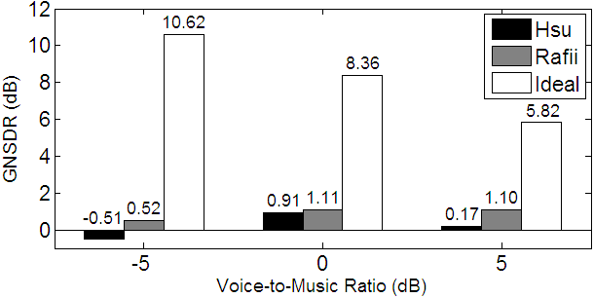
III. M/V separation – 1. Experiment
REPET vs. Hsu et al. [2010]:
Global music/voice separation performance between Hsu, REPET (Rafii) and using the ideal binary mask
Rafii & Pardo, ICASSP 2011

Slide 42
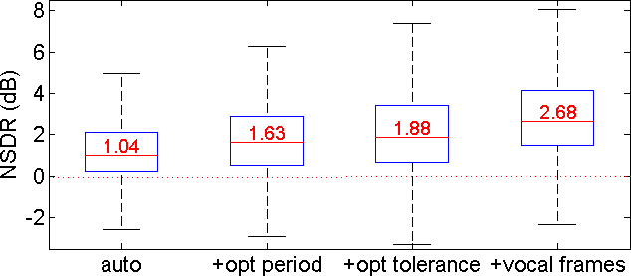
III. M/V separation – 1. Experiment
REPET vs. Hsu et al. [2010]:
Music/voice separation performance at voice-to-music ratio of 0 dB using REPET and successive enhancements
Rafii & Pardo, ICASSP 2011

Slide 43
Plan
Introduction
REPET Algorithm
Identify a repeating period
Model a repeating segment
Extract the repeating structure
Music/Voice Separation
Experimental results
Audio examples
Future work
Conclusion

Slide 44
III. Music/Voice – 2. Examples
REPET vs. Ozerov et al. [2008]:
Adapt accompaniment model from non-vocal frames
The Prodigy – Breathe

Slide 45
III. Music/Voice – 2. Examples
REPET vs. Ozerov et al. [2008]:
Adapt accompaniment model from non-vocal frames
The Doors – People are strange

Slide 46
III. Music/Voice – 2. Examples
More audio examples:
RJD2 – Ghostwriter (no vocals)
The Blues Brothers – Sweet Home Chicago ☺

Slide 47
Plan
Introduction
REPET Algorithm
Repeating period identification
Repeating segment modeling
Repeating structure extraction
Music/Voice Separation
Experimental evaluation
Audio examples
Future work
Conclusion

Slide 48



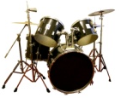
III. Music/Voice – 3. Future
Extraction of a hierarchical repeating structure:
Extract multiple repeating layers at different period rates
musical piece
p₃
p₂
p₁
time
vocal component
melody
model
melody component
bass
model
bass component
beat
model
beat component
time
time

Slide 49
III. Music/Voice – 3. Future
Use of a smart segmentation:
Model different repeating segments from/for different regions
verse 1
model
verse 2
model
non-repeating foreground
time
p
time
repeating background
chorus
model
time

Slide 50
III. Music/Voice – 3. Future
Use of a similarity matrix:
Identify and extract individual repeating elements
similarity matrix
lag 2
musical piece
time
lag 1
musical piece
time
element 1
model
element 2
model

Slide 51
Plan
Introduction
REPET Algorithm
Repeating period identification
Repeating segment modeling
Repeating structure extraction
Music/Voice Separation
Experimental results
Audio examples
Future work
Conclusion

Slide 52
IV. Conclusion
REPET: REpeating Pattern Extraction Technique
Music/voice separation by extraction of the underlying repeating musical structure
Strengths:
Simple
Fast
Blind
Automatable
Promising…

Slide 53

Questions ?

